Slide 1

PWC FORAGE INTERNSHIP
Task 2 – Quant Finance Modelling

Slide 2

Porfolio valuation
Value in 31.12.2020:
PWC Portfolio Valuation | 84779941.82276757
Client valuation | 84’993’122.67
Absolute difference | 17’852’668.06
Relative difference | 0.21
500’000 CHF

Slide 3
Appendix

Slide 4
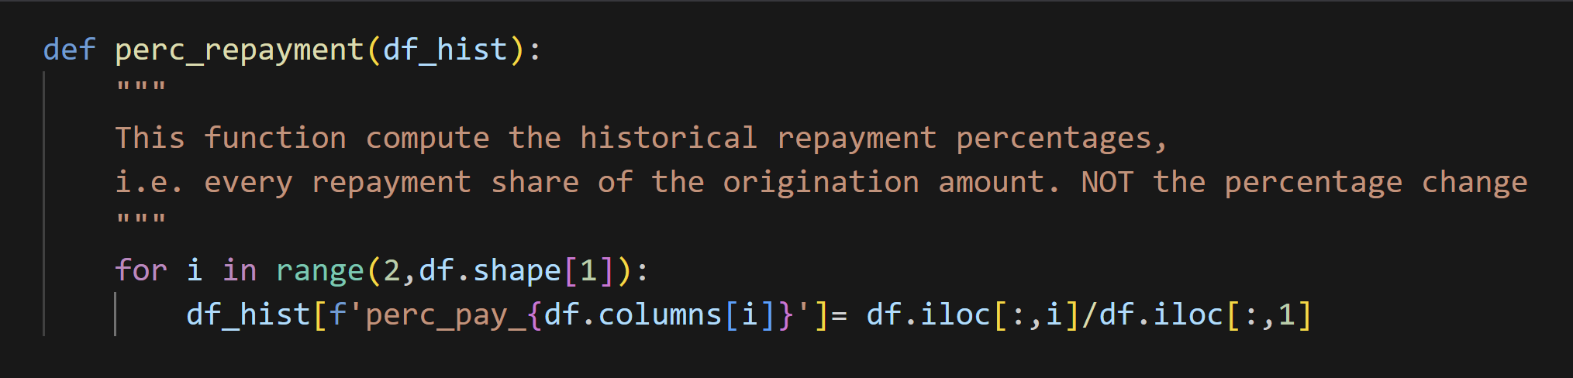
1) Compute the historical repayment percentage

Slide 5

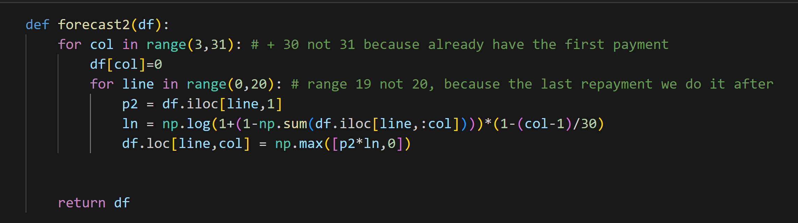
2) Compute the expected repayment pourcentage

Slide 6
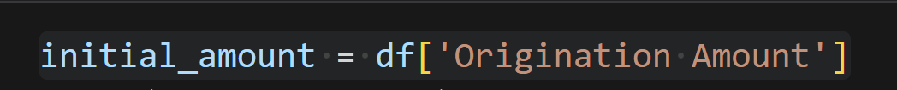
2) Compute the expected repayment given the pourcentage

Slide 7
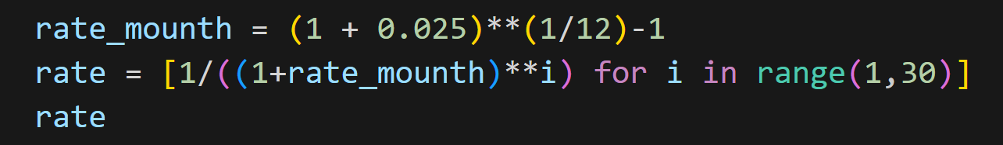
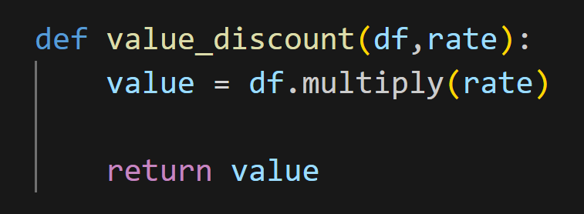
4) Compute the discounted cash flow

